Slide 1
EHS&S Monthly Recognition
JULY 2023

Slide 2
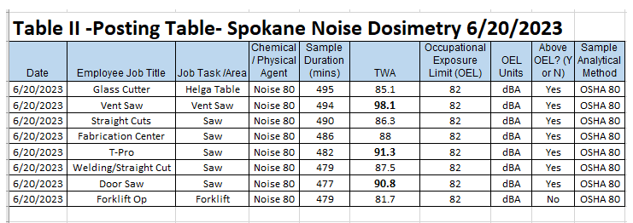
Background
On June 20th Richard Simmons conducted audiometric testing in the Spokane plant and found three areas that had a TWA above 90 dBa.
On June 21st Spokane started working on ways to reduce sound in the plant.
Fixing air leaks and building enclosures for all of the saws
All of our saws have open grate like guarding and easily removed covers. They protect someone from inserting a finger but do not block any noise.
2

Slide 3
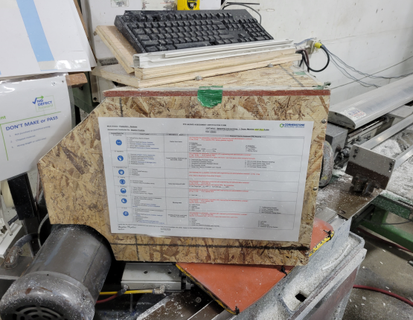
Enclosures
Darrell Dawson A newer technician to CBB was tasked to make encasements for all the saws. He made templates of all the saws enclosures and then built them on swing shift.
We used plywood for now and lined the inside of them with dynamat, foam and or felt.
Like STC (sound transmission windows) we take advantage of using two materials of different thickness to reduce frequencies of sound transmission.
The foam, felt, and dynamat act as further sound and vibration absorption.

Slide 4
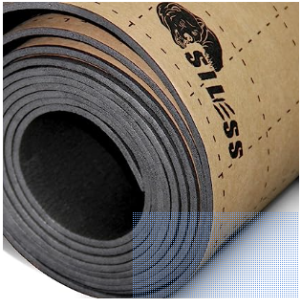
Overview
Bill of materials-
OSB – 7/16 inch 1 sheet per saw ……….. $19.18
Sound Dead dynamat 36sft per saw ……..$49
Flat head screws (Each) ………………..$.21
Labor 4-5 hours per saw.
Each saw needed it’s own template and fit to
ensure the covers did not Interfere with the operation or pose other safety hazards.
It has made a noticeable difference in the
Shop in reducing the noise exposure
On a Follow Up EHS visit by
Richard Simmons Emery Burger a sawyer
For the last 16 years expressed his
Gratitude for the help on this issue
We reduced the Avg dBa by 2-4 shop wide just building 3 enclosures.
This task took two weeks it was completed on July 6th.
The cost was relatively inexpensive.
For a more detailed process and run down Email
Stephan Hopkins
Stephan.Hopkins@cornerstone-bb.com

